Slide 1
Assertions
Slides to elaborate on JUnit Assertions and AssertJ Fluent Assertions by adding the maven dependencies to POM.XML file.
The JUnit Assertion on this occasion is:
assertTrue(actuals == expected, "Add JUNIT successful");
The AssertJ Fluent Assertion is:
assertThat(actuals).isEqualTo(expected);

Slide 2
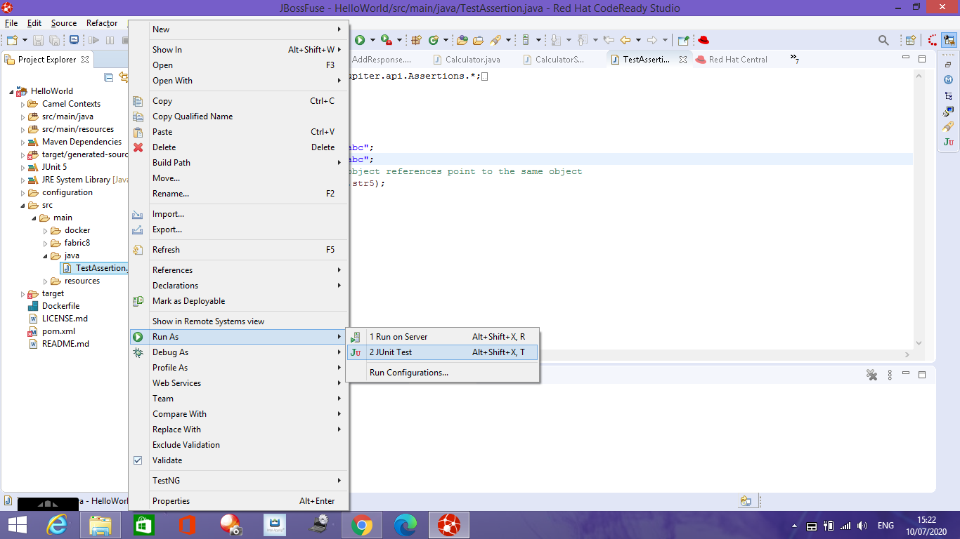
JUnit Assertions. Run as JUnit Test
assertTrue(actuals == expected, "Add JUNIT successful");

Slide 3
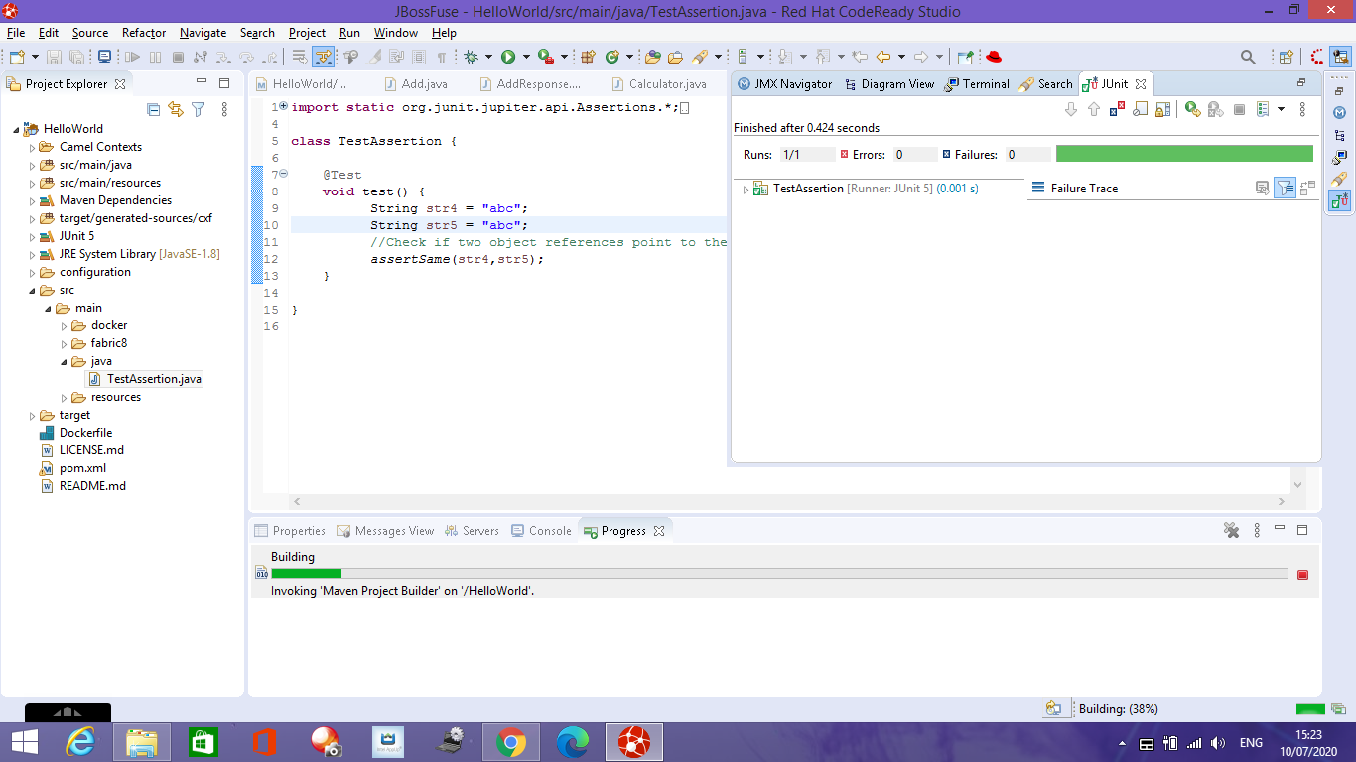
Junit Assertion Passed

Slide 4
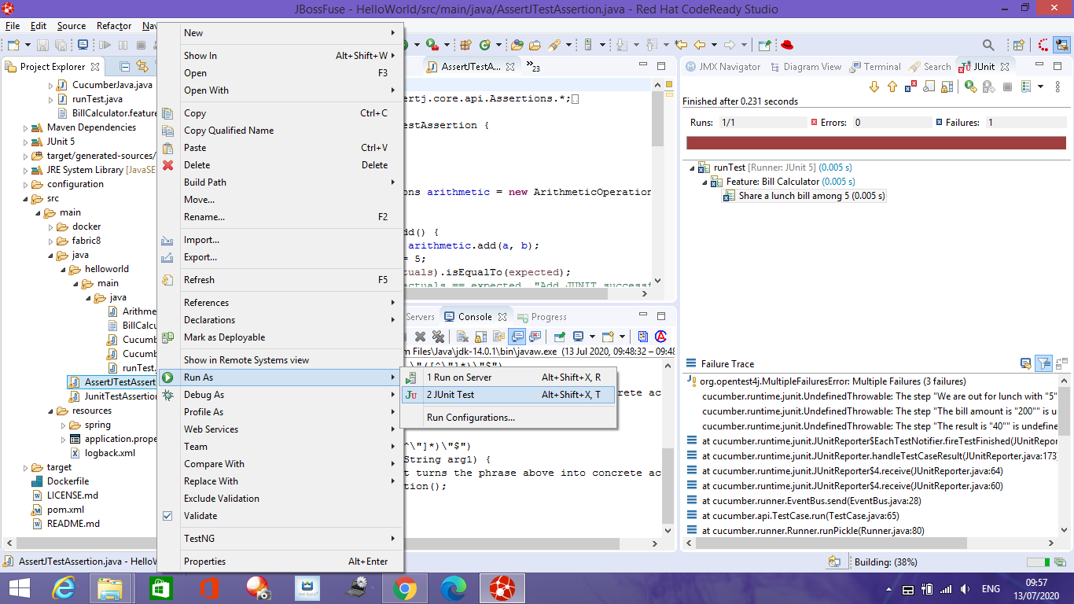
AssertJ Fluent Assertions. Run as JUnit
assertThat(actuals).isEqualTo(expected);

Slide 5
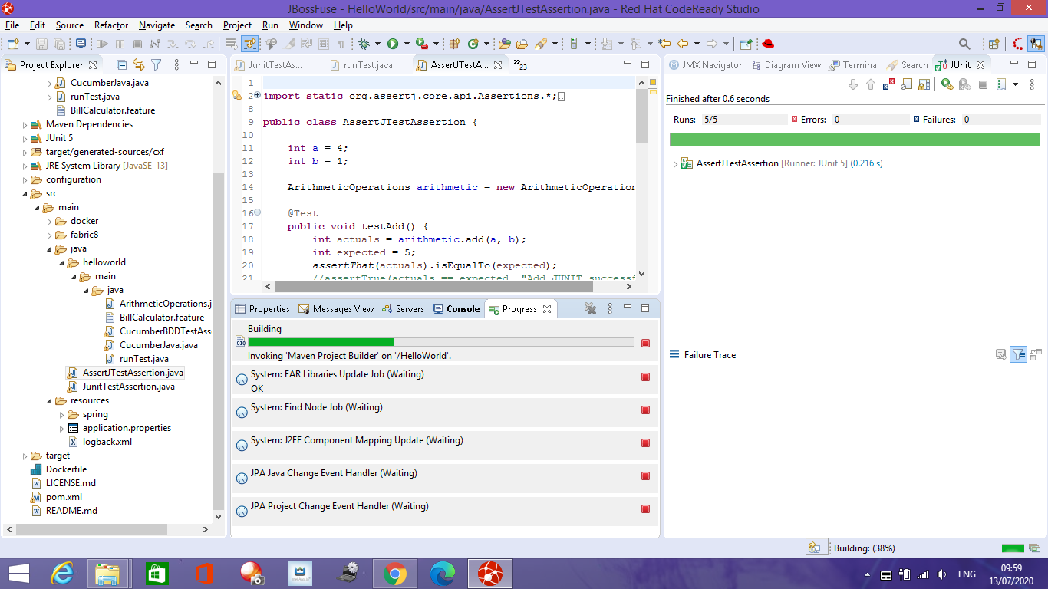
AssertJ Fluent Assertions passed

